Slide 1

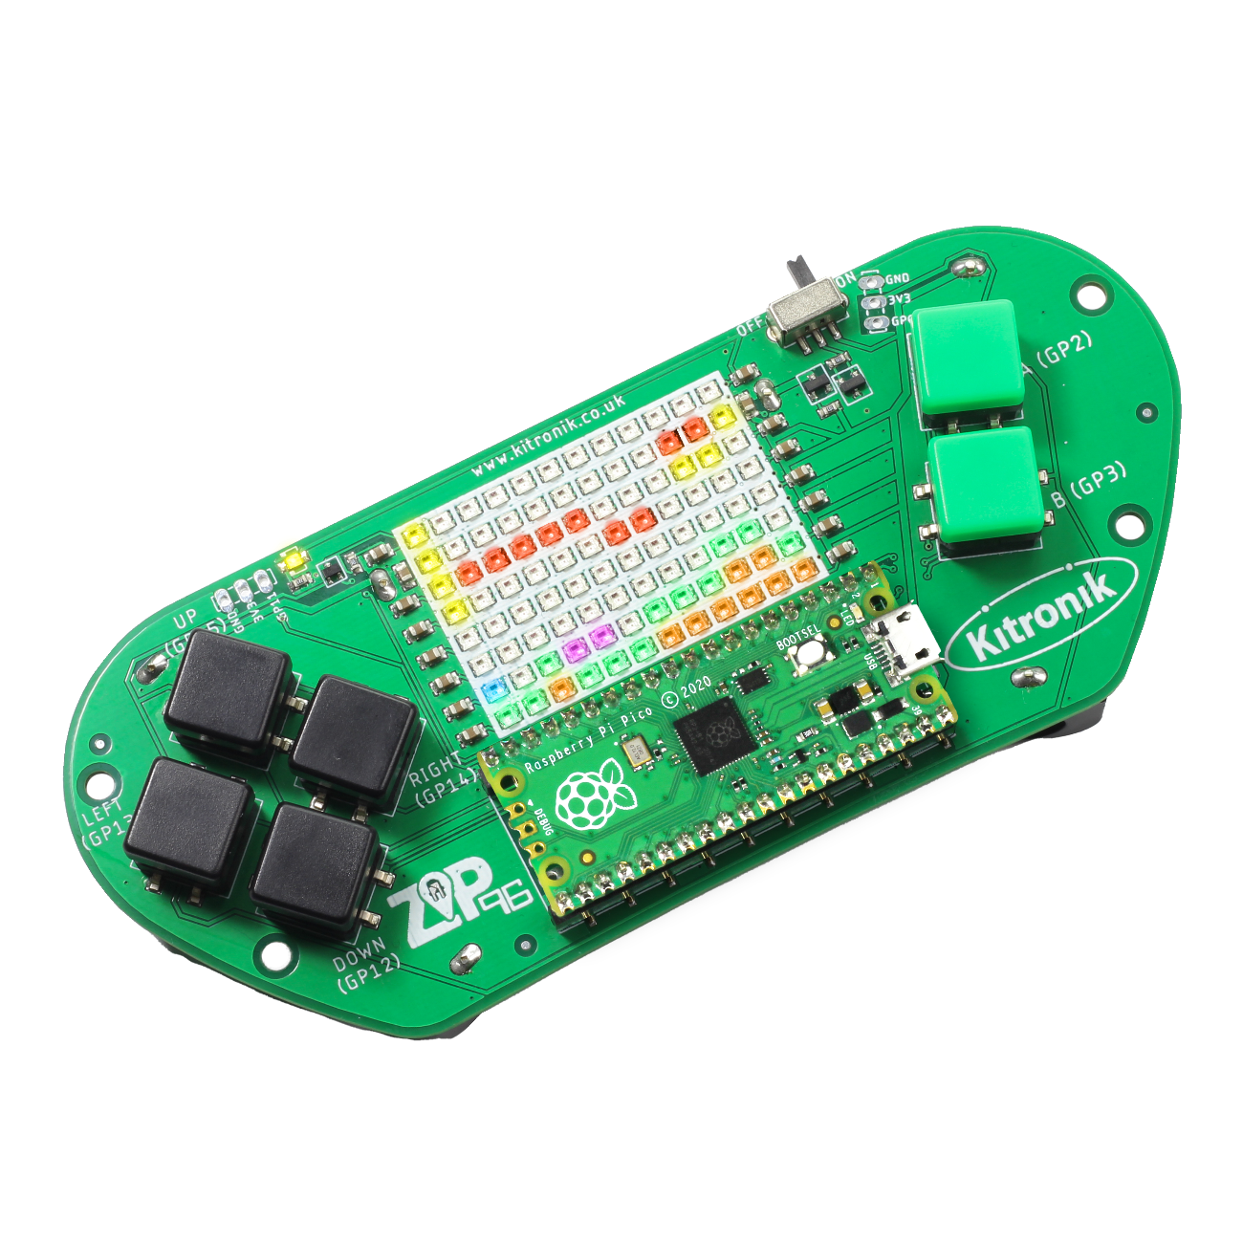
creating the a-mazing game
Computer Science

Slide 2

Aims & objectives
Computer Science
By the end of this lesson you will have:
Created a second enemy object.
Written the code to give the second enemy the functionality to move around the walls in the direction of the player.

Slide 3
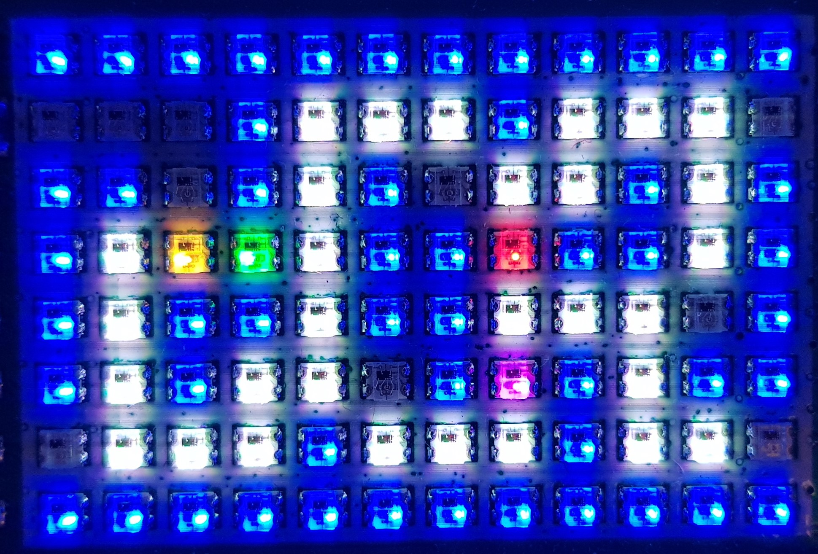
What is our a-mazing game?
Computer Science
A maze-based game where the player runs through a maze collecting gems – collect all the gems to win.
Three different enemies move around the maze as well, trying to stop the player from collecting gems.
One enemy moves randomly, one simply tries to move towards the player, the final one is smart and finds the best path through the maze to the player.
If an enemy catches the player, they lose a life. Once all three lives are lost… game over!

Slide 4
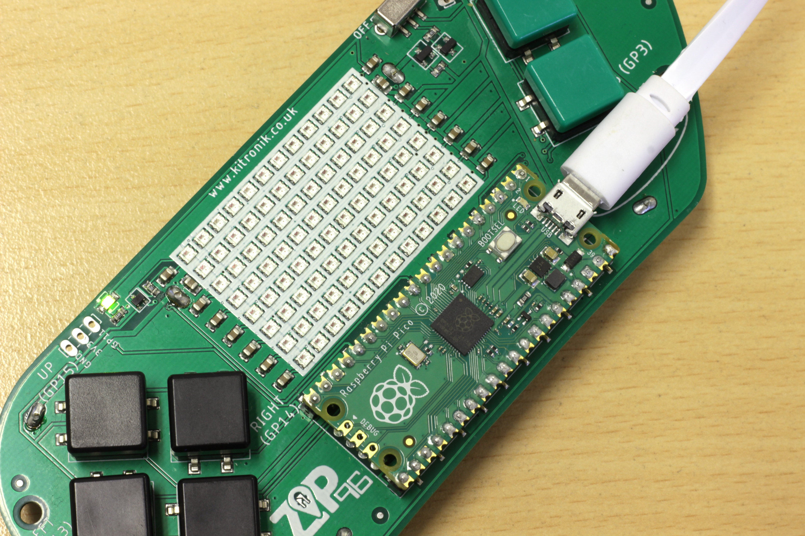
Thonny setup
Computer Science
Connect Pico ZIP96 to computer using a USB cable and open Thonny.

Slide 5
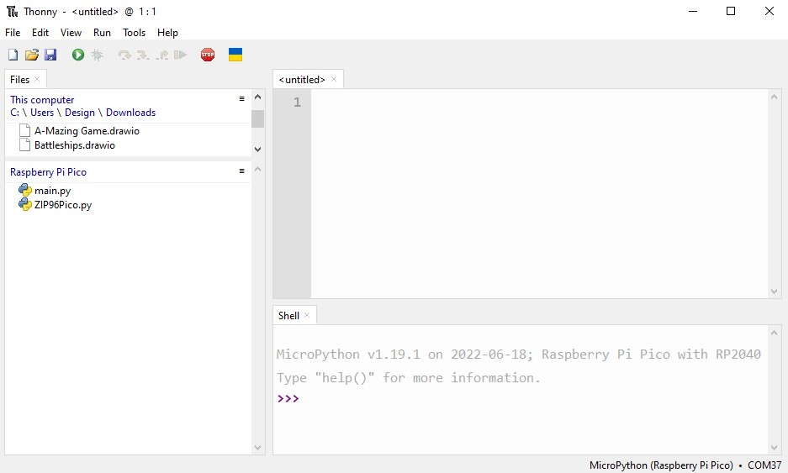
Thonny setup
Computer Science
Check the Pico device appears in the bottom right corner of Thonny.
Try pressing STOP if it does not appear automatically.
Turn on the ‘Shell’ by going to ‘View > Shell’.

Slide 6
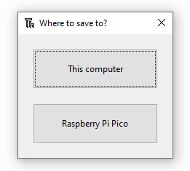
Thonny setup
Computer Science
Create a new file by clicking ‘File > New’.
Save it to the Pico by clicking ‘File > Save as’ and then select ‘Raspberry Pi Pico’.
Name the file ‘main.py’.

Slide 7
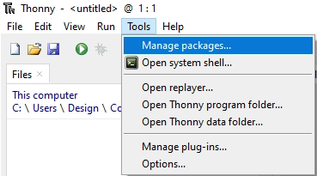
Thonny setup
Computer Science
Install the ‘ZIP96Pico’ library onto the Pico.
Click on ‘Tools > Manage Packages…’

Slide 8
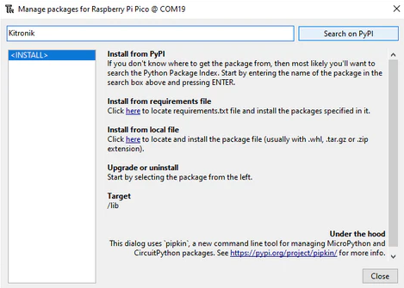
Thonny Setup
Computer Science
With the ‘Manage packages’ window open, search for ‘Kitronik’ and click the ‘Search on PyPI’ button.
Locate ‘KitronikPicoZIP96’ in the list of search results, then click the ‘Install’ button.
Confirm the install by clicking ‘Yes’ if prompted by Thonny.

Slide 9
Coding: Start second enemy
Computer Science
After the moveRandom() function in the Enemy class, define a new function:
# Update the current position towards Player x, y
def moveNormal(self):
# Reset the current position on the screen
self.drawEmpty()
# Reset hitPlayer
self.hitPlayer = False

Slide 10

Coding: Start second enemy
Computer Science
Given the x, y coordinates for both the player and the enemy, what algorithm can you come up with to work out which direction the enemy should move to head towards the player?

Slide 11
Coding: move towards the player
Computer Science
Add into the end of the new moveNormal() function:
# If Player x is less, decrease x
if self.player.x < self.x: x = -1
# Otherwise, increase x
else: x = 1
# If Player y is less, decrease y
if self.player.y < self.y: y = -1
# Otherwise, increase y
else: y = 1

Slide 12
Coding: choosing x or y axis
Computer Science
Add into the end of the new moveNormal() function:
# Is the distance from the Player bigger in the x axis or y axis
changeX = abs(self.player.x - self.x) > abs(self.player.y - self.y)
# Try change in the direction with the biggest distance
if changeX: self.x += x
else: self.y += y

Slide 13
Coding: dealing with wall collisions
Computer Science
Add into the end of the new moveNormal() function:
collision = False
# Check each Wall in our list
for wall in self.walls:
# If the Enemy is colliding with a Wall
if wall.collision(self.x, self.y):
# Undo the new position in the direction we changed
if changeX: self.x -= x
else: self.y -= y
# Invert changeX
changeX = not changeX
# Set we had a collision
collision = True
# Cannot collide with more than one Wall so leave loop
break

Slide 14
Coding: player collisions
Computer Science
Add into the end of the new moveNormal() function:
# If the Enemy is colliding with the Player
if self.player.collision(self.x, self.y):
# Set hitPlayer
self.hitPlayer = True
# Update the new position on the screen
self.draw()

Slide 15
Coding: add enemy functionality to game
Computer Science
Add the second enemy object to the list:
In the game loop, after the moveRandom() call, add the second enemy:
In the livesUpdate() function, reset the second enemy:
# List to store our Enemy objects
enemies = [Enemy(6, 2, gamer.Screen.RED, walls, gems, player, screen, screenWidth, screenHeight),
Enemy(5, 5, gamer.Screen.GREEN, walls, gems, player, screen, screenWidth, screenHeight)]
if i == 0: enemies[i].moveRandom()
# Second Enemy moves towards Player x, y
elif i == 1: enemies[i].moveNormal()
# Reset the Enemy positions
enemies[0].reset(6, 2)
enemies[1].reset(5, 5)

Slide 16
Test the second enemy
Computer Science
Run the program to test how the second enemy functions
What improvements can be made to the enemy functionality, making use of the change and collision variables?

Slide 17
Coding: dealing with wall collisions
Computer Science
In the moveNormal() function, before checking for player collisions:
# If we had a collision
if collision:
# Try change in the other direction
if changeX: self.x += x
else: self.y += y
# Check each Wall in our list
for wall in self.walls:
# If the Enemy is colliding with a Wall
if wall.collision(self.x, self.y):
# Undo the new position in the diretion we changed
if changeX: self.x -= x
else: self.y -= y
# Cannot collide with more than one Wall so leave loop
break

Slide 18
Test the second enemy again
Computer Science
Run the program to test how the second enemy functions with the improved collision handling

Slide 19
conclusion
Computer Science
In this lesson you have:
Created an Enemy move function to use logic to move towards the Player.
Used a for loop, if statement and Boolean to check for interaction between Enemy and Wall objects.

